Slide 1
Object-driven Text-to-Image Synthesis via Adversarial Training
CVPR 2019
Wenbo Li* Pengchuan Zhang* Lei Zhang Qiuyuan Huang
Xiaodong He Siwei Lyu Jianfeng Gao
University at Albany, SUNY Microsoft Research AI

Slide 2
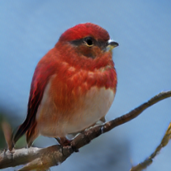
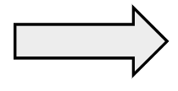
Motivation
Text description to image translation
This bird is red with white and has a very short beak.
Generate

Slide 3
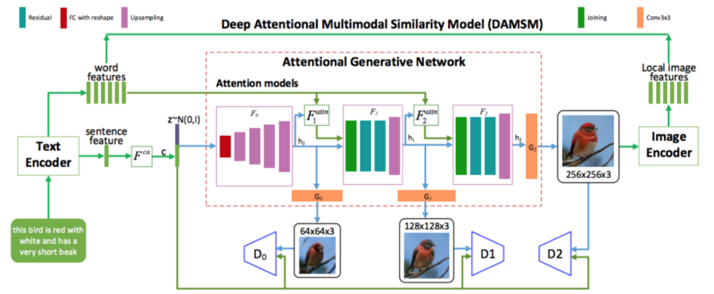
Text-to-Image: Previous Approach
AttnGAN
Introduces the attention mechanism into the GAN framework
[1] Attngan: Fine-grained text to image generation with attentional generative adversarial networks, Xu et al., CVPR 2018

Slide 4
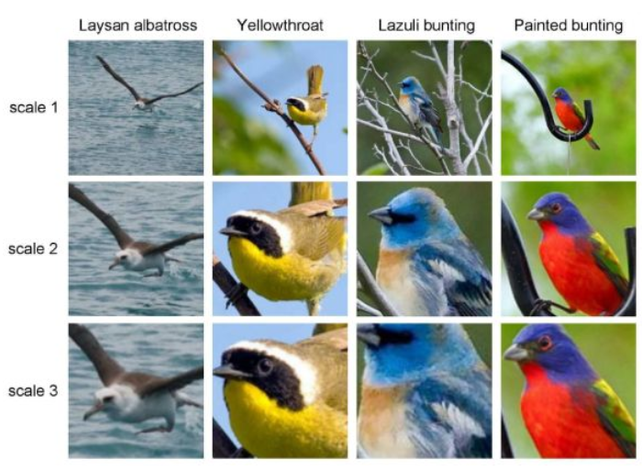
Attention Mechanism
Birds Classification
Look closer to see better !
Highlight more critical information .

Slide 5

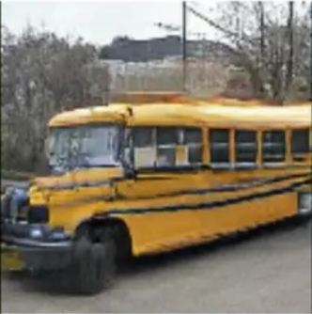
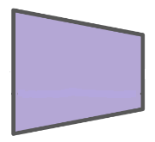
GAN (Generative Adversarial Networks)
z~N(0,1)
Generator
Discriminator
Result
G
Real
D
or
Fake

Slide 6
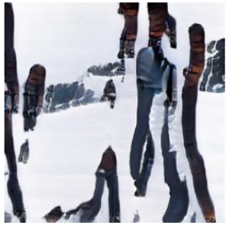

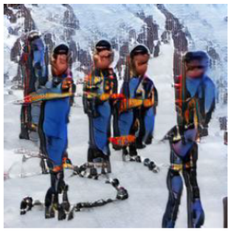

Text-to-Image: Previous Approach
Several people in their ski gear are in the snow.
AttnGAN
Obj-GAN
AttnGAN grid attention
obj-GAN object-driven attention

Slide 7
Obj-GAN: Contribution
1. Specializing in synthesizing complex images from text descriptions
2. Two novel components are proposed, including the object-driven attentive generative network and the object-wise discriminator
3. Comprehensive evaluation on a large-scale COCO benchmark shows
that Obj-GAN outperforms previous state-of-the-art text-to-image synthesis methods

Slide 8
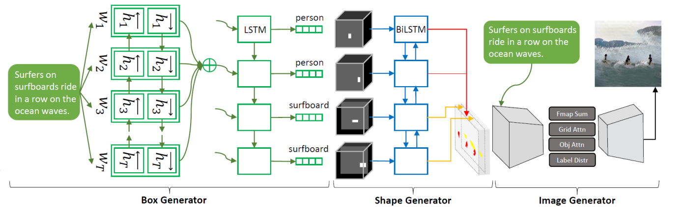
Obj-GAN:
Step 1: Generating a semantic layout
(class labels, bounding boxes, shapes of salient objects)
Step 2: Generating the image

Slide 9
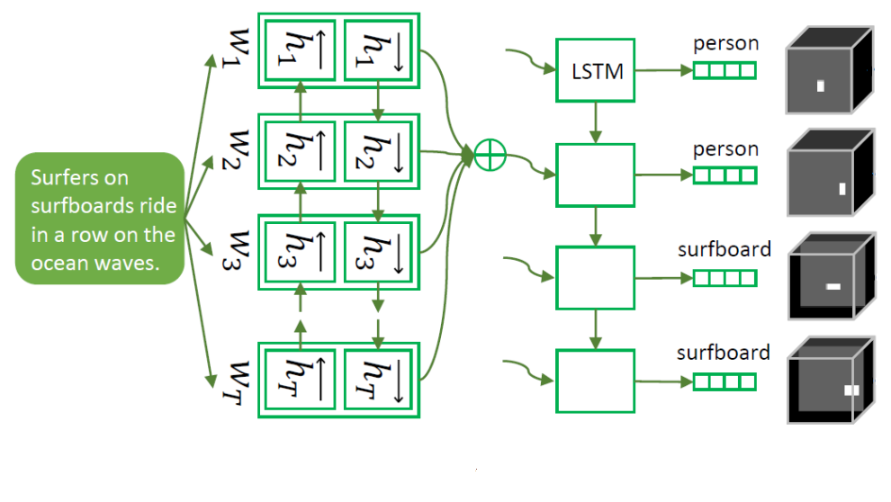
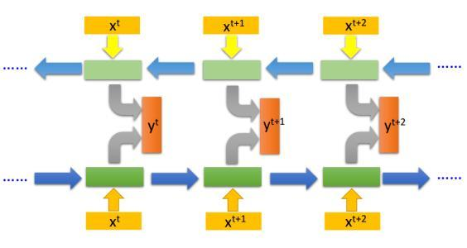



Box Generator
T tokens (words)
T = 11
bi-LSTM encoder
surfboards
t = 2
ride
t = 3
in
t = 4
Word vectors
Global sentence vector
Its column is the feature vector for the word.
D is the dimension of the word vector.
is the number of words.
surfboards
t = 2
ride
t = 3
in
t = 4

Slide 10



Box Generator
Attentive seq2seq model[1]
are the pre-trained bi-LSTM word vectors
are the class label of the t's object and its bounding box
[1] Neural machine translation by jointly learning to align and translate., Bahdanau et al., arXiv:1409.0473

Slide 11
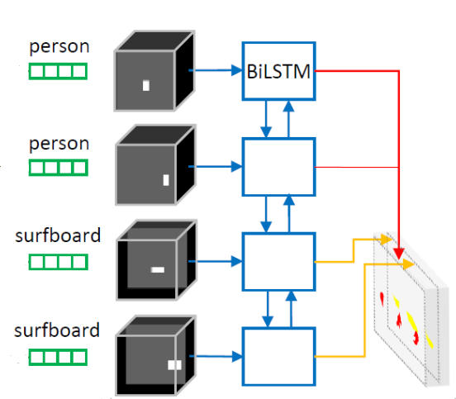

Shape Generator
Training based on GAN
bi-directional convolutional LSTM

Slide 12
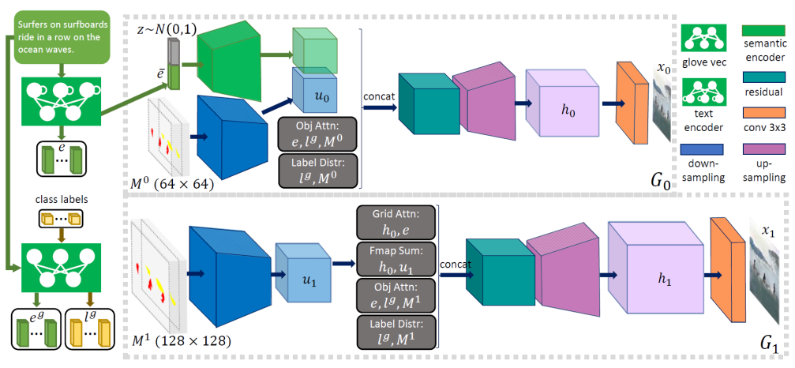
Image Generator
Attentive Multi-stage Image Generator

Slide 13
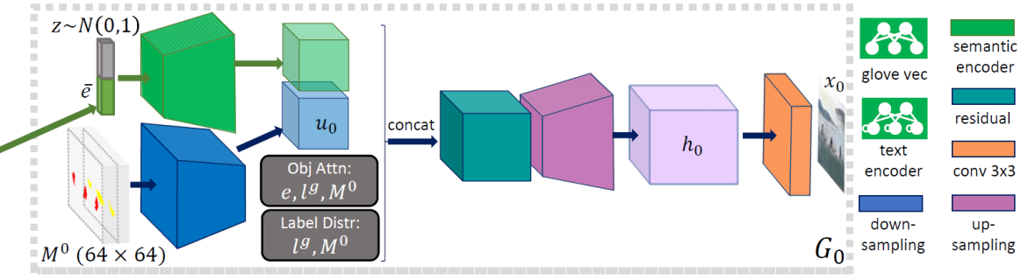

Base Generator (G0)
object context feature
label context feature

Slide 14
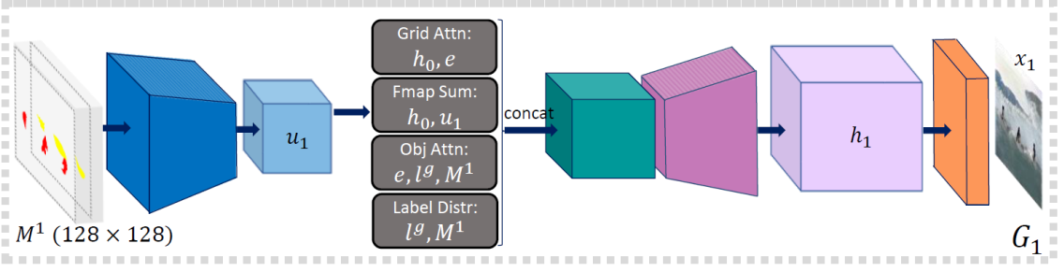
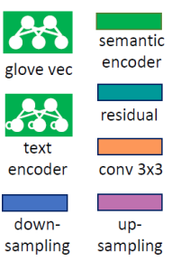
Refiner (G1)
patch-wise context vector

Slide 15
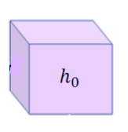
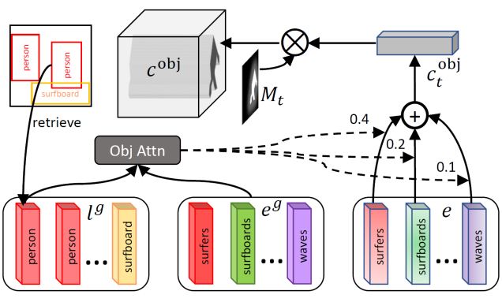



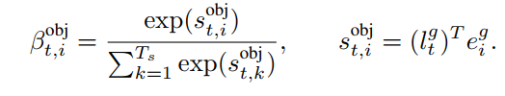


Compute context vectors via attention
Patch-wise context vector
(Grid Attention)
Object-wise context vector
(Object-driven Attention)
If there are multiple bounding boxes covering the same
pixel, max-pooling to decide whose context vector should be used on this pixel.
Label context vector

Slide 16



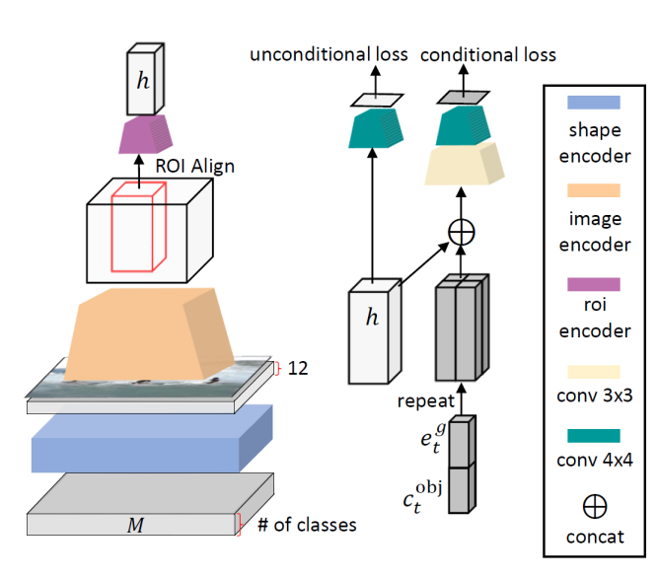


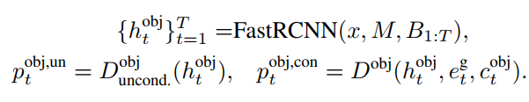
Discriminators
Enc is a convolutional feature extractor that extracts patch-wise features
Patch-wise unconditional discriminator
Patch-wise text discriminator
where x is generated image.
determine whether the patch is realistic.
where is sentence vector.
determine whether the patch is consistent with the text description.
Patch-wise shape discriminator
where first concatenate the image x and shapes M in the channel dimension
then extracts patch-wise features by Enc
determine whether the patch is consistent with the given shape.
Object-wise discriminators

Slide 17
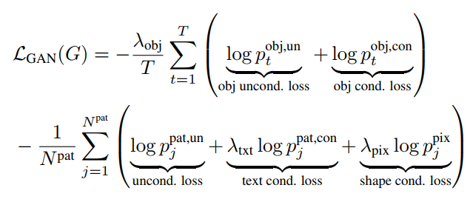

Loss function for the image generator
Multi-modal
Semi-supervised

Slide 18
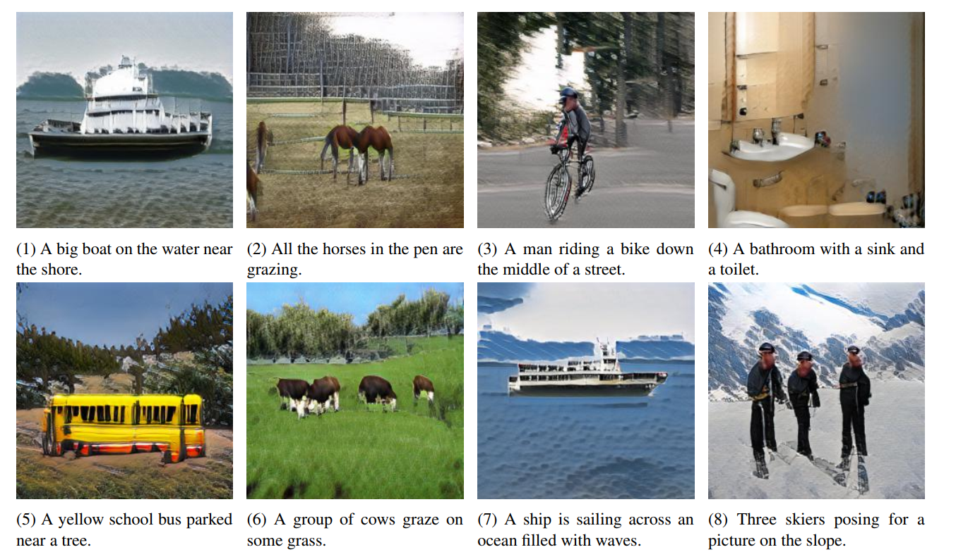
Results

